Slide 1
GRADE 7 ACCELERATED · UNIT 5 · LESSONS 10–11
Multi-Step Proportion Problems
MA.7.AR.4.5
I can solve a problem that takes two or more proportional steps, including a unit conversion, and compare two rates given in different units.
Grade 7 Accelerated · Unit 5 · Lessons 10–11 — Multi-Step Proportion Problems
1

Slide 2



Warm-Up
1.
. How many pounds is 4 kg?
2. At
, 3 cm on the map is how many km?
3. Find the value:
4. A car goes 180 miles in 3 hours. Its speed in miles per hour?
Grade 7 Accelerated · Unit 5 · Lessons 10–11 — Multi-Step Proportion Problems
2

Slide 3
Warm-Up
1.
. How many pounds is 4 kg?
8.816 lb
2. At
, 3 cm on the map is how many km?
150 km
3. Find the value:
9
4. A car goes 180 miles in 3 hours. Its speed in miles per hour?
60 miles per hour
Grade 7 Accelerated · Unit 5 · Lessons 10–11 — Multi-Step Proportion Problems
3

Slide 4
Vocabulary
unit rate
how much of one quantity per 1 of the other — 23 miles per 1 gallon
proportional
two quantities whose ratio stays the same: double one, the other doubles
per
for each 1 — the word that marks a unit rate
Grade 7 Accelerated · Unit 5 · Lessons 10–11 — Multi-Step Proportion Problems
4

Slide 5
Notes
I. One unit rate, used twice
Grade 7 Accelerated · Unit 5 · Lessons 10–11 — Multi-Step Proportion Problems
5

Slide 6
Notes
II. Compare rates in one unit
Same unit first. Then compare.
Grade 7 Accelerated · Unit 5 · Lessons 10–11 — Multi-Step Proportion Problems
6

Slide 7
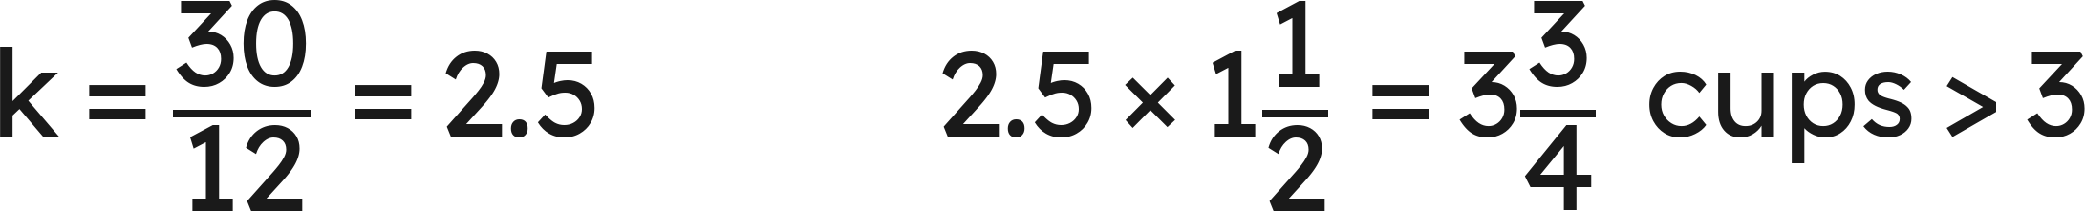
Notes
III. Scale a recipe, then check the pantry
Grade 7 Accelerated · Unit 5 · Lessons 10–11 — Multi-Step Proportion Problems
7

Slide 8

Example 1
.
Runner A does 5 mi in 40 min; runner B does 9 km in 45 min.
Find each speed in km/h. Who is faster?
Grade 7 Accelerated · Unit 5 · Lessons 10–11 — Multi-Step Proportion Problems
8

Slide 9
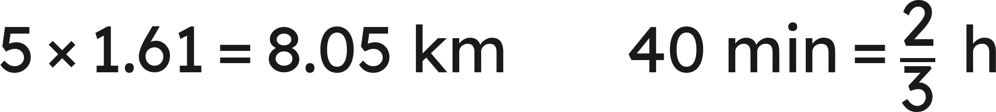
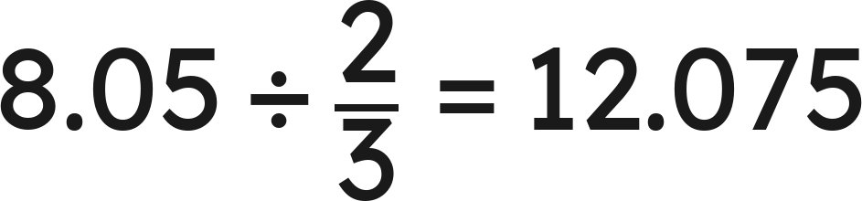
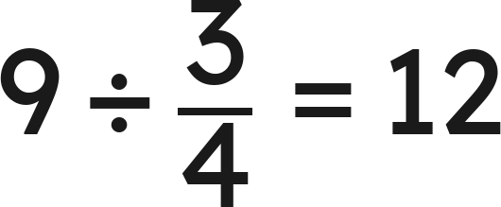

Example 1
Answer: A ≈ 12.08 km/h, B = 12 km/h: A
Grade 7 Accelerated · Unit 5 · Lessons 10–11 — Multi-Step Proportion Problems
9

Slide 10

Your Turn
.
Runner A does 4 mi in 30 min; runner B does 7 km in 35 min.
Find each speed in km/h. Who is faster?
Grade 7 Accelerated · Unit 5 · Lessons 10–11 — Multi-Step Proportion Problems
10

Slide 11

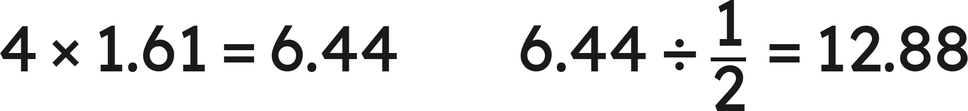
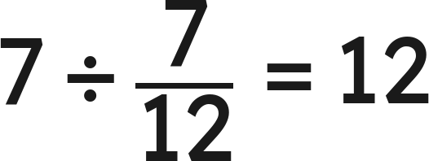
Your Turn
.
Runner A does 4 mi in 30 min; runner B does 7 km in 35 min.
Find each speed in km/h. Who is faster?
Answer: A = 12.88 km/h, B = 12 km/h: A
Grade 7 Accelerated · Unit 5 · Lessons 10–11 — Multi-Step Proportion Problems
11

Slide 12

Example 2
A recipe for 8 servings uses
cups of rice.
How much rice for 20 servings? With 5 cups on hand, how many servings can be made?
Grade 7 Accelerated · Unit 5 · Lessons 10–11 — Multi-Step Proportion Problems
12

Slide 13
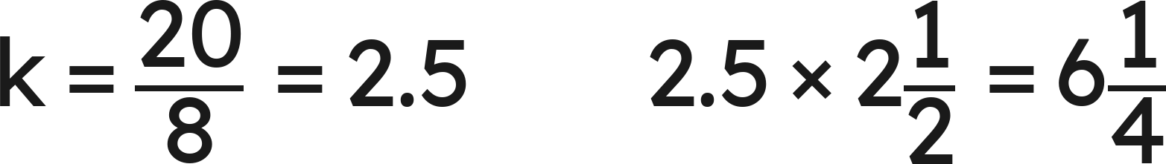
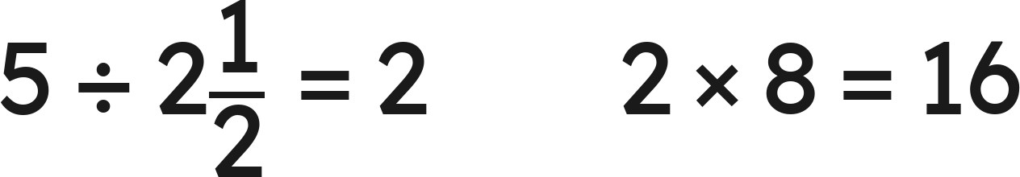
Example 2
Answer: 6¼ cups; 16 servings
Grade 7 Accelerated · Unit 5 · Lessons 10–11 — Multi-Step Proportion Problems
13

Slide 14


Your Turn
A recipe for 6 servings uses
cups of rice.
How much rice for 12 servings?
With
cups on hand, how many servings?
Grade 7 Accelerated · Unit 5 · Lessons 10–11 — Multi-Step Proportion Problems
14

Slide 15


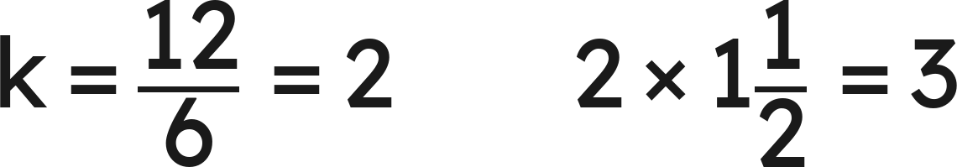
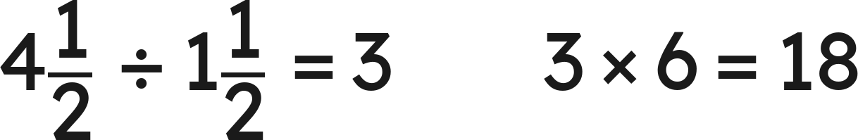
Your Turn
A recipe for 6 servings uses
cups of rice.
How much rice for 12 servings?
With
cups on hand, how many servings?
Answer: 3 cups; 18 servings
Grade 7 Accelerated · Unit 5 · Lessons 10–11 — Multi-Step Proportion Problems
15

Slide 16
Whiteboards · Question 1 of 9
A car gets 28 miles per gallon. Its tank holds 15 gal.
How far does it go on a full tank?
Answer it.
Grade 7 Accelerated · Unit 5 · Lessons 10–11 — Multi-Step Proportion Problems
16

Slide 17

Whiteboards · Question 1 of 9
A car gets 28 miles per gallon. Its tank holds 15 gal.
How far does it go on a full tank?
Answer: 420 mi
Grade 7 Accelerated · Unit 5 · Lessons 10–11 — Multi-Step Proportion Problems
17

Slide 18
Whiteboards · Question 2 of 9
A printer prints 35 pages per minute. A job is 1,400 pages.
How long does the job take?
Answer it.
Grade 7 Accelerated · Unit 5 · Lessons 10–11 — Multi-Step Proportion Problems
18

Slide 19

Whiteboards · Question 2 of 9
A printer prints 35 pages per minute. A job is 1,400 pages.
How long does the job take?
Answer: 40 min
Grade 7 Accelerated · Unit 5 · Lessons 10–11 — Multi-Step Proportion Problems
19

Slide 20
Whiteboards · Question 3 of 9
Mia earns $14.50 per hour at a shop 2 mi from home, 6 h a day for 5 days.
How much does she earn?
Answer it.
Grade 7 Accelerated · Unit 5 · Lessons 10–11 — Multi-Step Proportion Problems
20

Slide 21
Whiteboards · Question 3 of 9
Mia earns $14.50 per hour at a shop 2 mi from home, 6 h a day for 5 days.
How much does she earn?
Answer: $435
Grade 7 Accelerated · Unit 5 · Lessons 10–11 — Multi-Step Proportion Problems
21

Slide 22




Whiteboards · Question 4 of 9
A car gets 30 miles per gallon with a 12-gal tank. It makes a 900-mi trip.
How many tanks of gas does the trip use? (Part of a tank counts as a whole tank.)
A.
B.
C.
D.
Answer it.
Grade 7 Accelerated · Unit 5 · Lessons 10–11 — Multi-Step Proportion Problems
22

Slide 23
Whiteboards · Question 4 of 9
A car gets 30 miles per gallon with a 12-gal tank. It makes a 900-mi trip.
How many tanks of gas does the trip use? (Part of a tank counts as a whole tank.)
Answer: D — 3 tanks
Grade 7 Accelerated · Unit 5 · Lessons 10–11 — Multi-Step Proportion Problems
23

Slide 24
Whiteboards · Question 5 of 9
A cereal has 12 g of protein per 100 g.
How many grams of protein in 1 kg?
Answer it.
Grade 7 Accelerated · Unit 5 · Lessons 10–11 — Multi-Step Proportion Problems
24

Slide 25
Whiteboards · Question 5 of 9
A cereal has 12 g of protein per 100 g.
How many grams of protein in 1 kg?
Answer: 120 g
Grade 7 Accelerated · Unit 5 · Lessons 10–11 — Multi-Step Proportion Problems
25

Slide 26

Whiteboards · Question 6 of 9
.
Cyclist A rides 12 km in 50 min; cyclist B rides 7 mi in 45 min.
Who is faster?
A. Tie: 12 and 12
B. A: 12 > 7
C. B: 15.0 > 14.4
D. A: 14.4 > 11.27
Answer it.
Grade 7 Accelerated · Unit 5 · Lessons 10–11 — Multi-Step Proportion Problems
26

Slide 27


Whiteboards · Question 6 of 9
.
Cyclist A rides 12 km in 50 min; cyclist B rides 7 mi in 45 min.
Who is faster?
Answer: C — cyclist B
Grade 7 Accelerated · Unit 5 · Lessons 10–11 — Multi-Step Proportion Problems
27

Slide 28

Whiteboards · Question 7 of 9
Paint is mixed white : blue : grey =
.
A batch uses 8 gal of white.
How many gallons is the whole batch?
Answer it.
Grade 7 Accelerated · Unit 5 · Lessons 10–11 — Multi-Step Proportion Problems
28

Slide 29



Whiteboards · Question 7 of 9
Paint is mixed white : blue : grey =
.
A batch uses 8 gal of white.
How many gallons is the whole batch?
Answer: 44 gal
Grade 7 Accelerated · Unit 5 · Lessons 10–11 — Multi-Step Proportion Problems
29

Slide 30


Whiteboards · Question 8 of 9
A plan is drawn at
; a room is 2 in by 2.5 in on it.
.
Find the room's area in square meters.
Answer it.
Grade 7 Accelerated · Unit 5 · Lessons 10–11 — Multi-Step Proportion Problems
30

Slide 31


Whiteboards · Question 8 of 9
A plan is drawn at
; a room is 2 in by 2.5 in on it.
.
Find the room's area in square meters.
Answer: About 7.44 m²
Grade 7 Accelerated · Unit 5 · Lessons 10–11 — Multi-Step Proportion Problems
31

Slide 32
Whiteboards · Question 9 of 9
.
A 300-km drive.
Car A averages 50 mi/h; car B averages 75 km/h.
Which car gets there first, and by how long? Explain.
Write your answer in sentences.
Grade 7 Accelerated · Unit 5 · Lessons 10–11 — Multi-Step Proportion Problems
32

Slide 33
Whiteboards · Question 9 of 9
.
A 300-km drive.
Car A averages 50 mi/h; car B averages 75 km/h.
Which car gets there first, and by how long? Explain.
Answer: Car A: 80.5 km/h against 75, so about 3.73 h against 4 h — about 16 minutes sooner.
Grade 7 Accelerated · Unit 5 · Lessons 10–11 — Multi-Step Proportion Problems
33

Slide 34




Independent Set
1.
A car gets 32 miles per gallon and its tank holds 14 gal. How far does it go on a
tank?
2.
That car makes a 1,000-mi trip. How many tanks of gas does it use? (Part of a
tank counts as a whole tank.)
3.
A recipe for 4 servings uses
cups of rice. How much rice for 10 servings?
4.
. A train does 120 km/h; a bus does 70 mi/h. Which is faster? Show
the speeds in one unit.
5.
Juice is mixed orange : mango : water =
. A batch uses 9 cups of orange.
How many cups is the whole batch?
6.
A plan is drawn at
; a room is 2 in by 3.5 in on it. Find the room's real area.
Grade 7 Accelerated · Unit 5 · Lessons 10–11 — Multi-Step Proportion Problems
34

Slide 35
IXL
1.
Open IXL and start today's skills.
2.
Work on paper where the question needs work. The answer box does not show it.
3.
Every skill listed is required, to a SmartScore of 67. Due by the Unit 5 test.
Today's skills — all required
Compare rates: word problems — VVS
Multi-step problems with customary or metric unit conversions — UCT
Grade 7 Accelerated · Unit 5 · Lessons 10–11 — Multi-Step Proportion Problems
35

